Slide 1





THE PILLAR LAW FIRM
E x p e r I e n c e I n n o v a t I o n

Slide 2




WHO WE
We are THE PILLAR LAW FIRM An innovative and flexible law firm focused on providing fast and reliable legal advisory and representation services to our clients. Since 2015, we have provided clients with exceptional services and expertise in business law matters, BAHER & JAMES Law Firm We have branches in the Arabian Gulf, China, and Europe.

Slide 3

Our MISSION
The consummation of deals and the practice and rendering of legal services to our clients efficiently and diligently are the reasons for our existence as one of the leading legal organizations. THE PILLAR Law Firm serves its clients by helping them achieve the business outcomes they desire. Our firm’s lawyers exhibit a steadfast willingness to explore the alternatives to help resolve disagreements, we are then able to work with the other parties to find and follow the best path to a resolution. It is through the use of these skills that we can deliver exceptional value for our clients.

Slide 4

Our VISION
Our vision is to provide our clients with skilled legal advice in a timely and efficient manner. And to strive to handle each matter with accountability and responsiveness, as if we were representing ourselves. We focus our attention on the legal aspects of our client’s business so that our clients can focus their attention on the success of their business, And reflect our values of Integrity, Excellence, and Quality of Service.

Slide 5

Our strategy
Our main business core is flagging risks and formulating solutions. In order to build a reputation for an uncompromising commitment to quality and responsiveness. And create innovative solutions to help and enable our clients to achieve their business goals in a timely and cost-efficient manner.

Slide 6


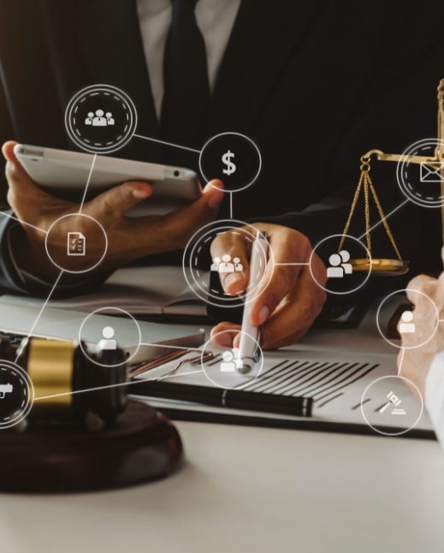
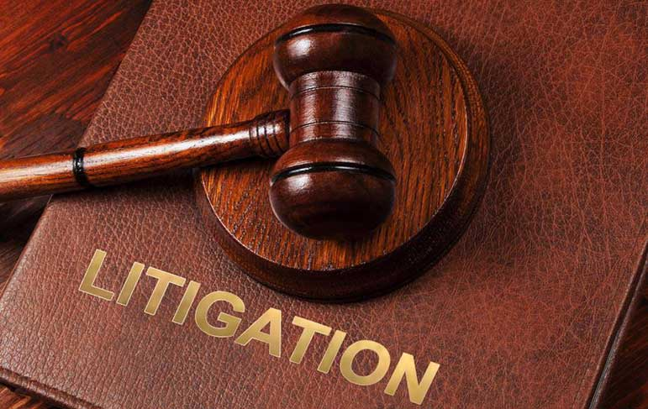
Our services
Establish companies within the European Union and China
International foreign investment
Labor contracts and labor issues
Litigation & Conslutation

Slide 7


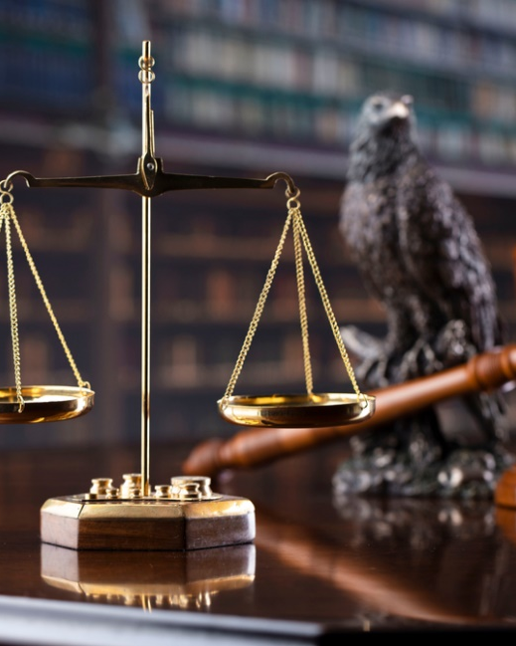
Our services
INFORMATION TECHNOLOGY
Labor contracts and labor issues
International Arbitration
Telecommunication

Slide 8




Our services
Merge & Acquisition
Drafting and reviewing contracts
INITIAL PUBLIC OFFERING (IPO)
Real estate Development

Slide 9
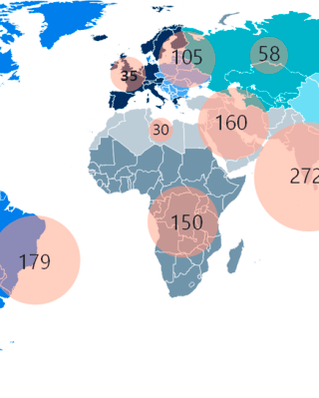



Our services
INDUSTRIAL & FREE ZONES SECTOR
BANKING & FINANCE
Mining
Company Formation

Slide 10


Why THE PILLAR Law Firm
Fast results
Best price
International
certificates
Live support
The easiest procedures for launching your company in the countries of the European Union and China and the ease of procedures in international cases
We offer the best prices in establishing companies and issues
Our company holds the highest international certificates in law and company formation
We offer our clients direct support and ease of procedures
READ MORE
READ MORE
READ MORE
READ MORE

Slide 11







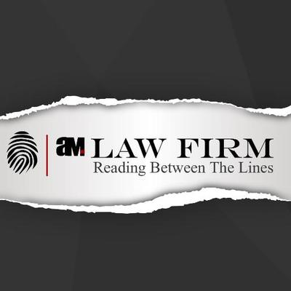
Our PARTNERS
IN CHINA
IN KUWAIT
IN BAHRAIN
IN DUBAI

Slide 12
Our SERVICES COVERAGE areas

Slide 13




Our clients

Slide 14




Our clients

Slide 15




Our clients

Slide 16




Our clients

Slide 17

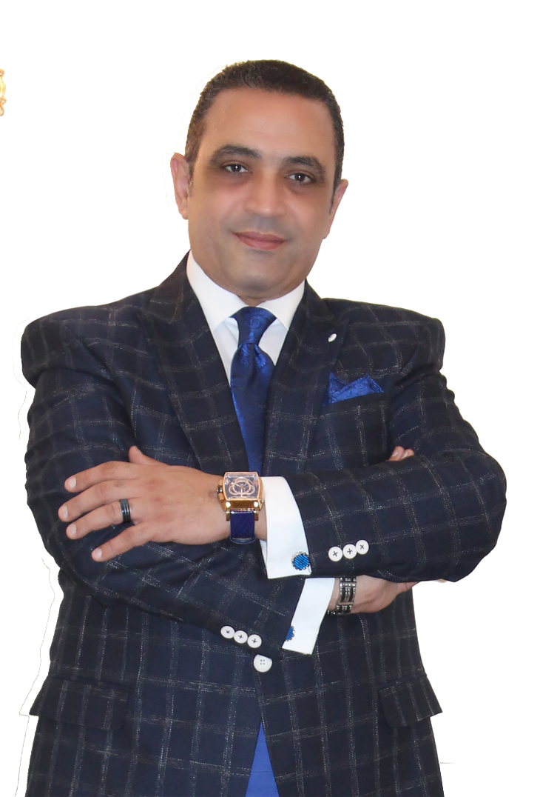
DR.BAHER EL-HADARY
Founder & Managing Partner
Dr. Baher had achieved his LL.B. from the Faculty of Law, Cairo University, in 1995 and has attended several courses at the American University and American Legal Center in Cairo.
Dr. Baher extensive education in law assists him in the cases he undertakes. He achieved a Ph.D. degree
(Doctorate at International Contract Law) - from the University of Bakerville in California - the United States of America in 2014.
Dr. Baher is the Managing Partner of BAHER & JAMES Law Firm and since his graduation, He manages a portfolio of more than 100 clients from different jurisdictions. He has been extensively involved in advising a large number of multi-national clients in Egypt and the Middle East regions for more than 15 years.
Dr. Baher has been involved in the drafting and negotiation of all major telecom contracts and transactions with VODAFONE, MOBINIL, ETISALAT, and Telecom Egypt.

Slide 18

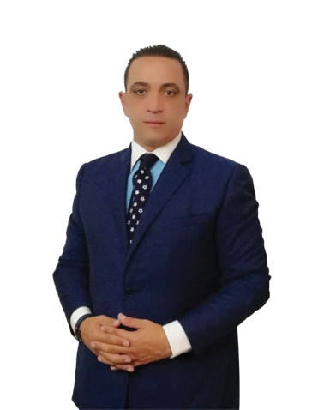
DR.BAHER EL-HADARY
Founder & Managing Partner
Dr. Baher has focused on the area of corporate law, and business law locally and internationally, he was involved in hundreds of restructurings and incorporations of foreign and domestic companies and advising local and international investors on the most efficient vehicles and structures for implementing their investment in Egypt as well as continuing to provide his clients with advice on all aspects of doing business in Egypt. Such as the M&A and Capital Markets experience, he also has experience in conducting legal due diligence on various types of companies including telecommunication, information technology, real estate, investment, brokerage, and holding companies.
Dr. Baher dedication and a wide range of contracts greatly contributed to the growth of the Firms capabilities, while maintaining its standards of excellence.
Dr. Baher was admitted before the Egyptian Court of Cassation in 2014. He is also a member of the Egyptian Bar Association and the American Bar Association (“ABA”).

Slide 19

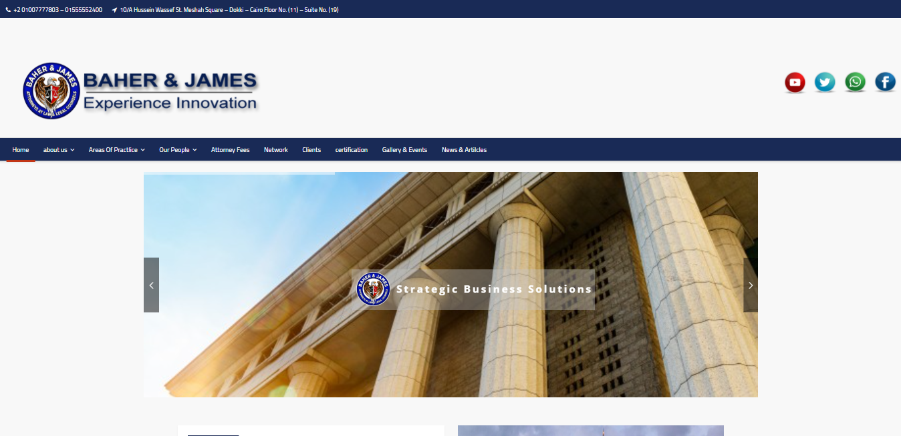
Visit our website
www.baherlaw-egypt.com

Slide 20

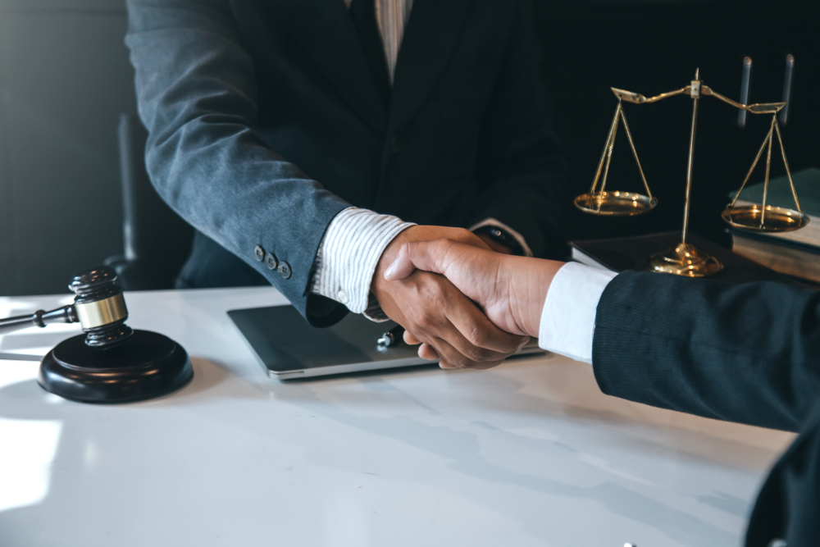





Start Your consultation now
www.baherlaw-egypt.com
Baher & James Law Firm
info@baherlaw-Egypt.com
+201007777803 – +201555552400 - +201110277750
Bank Misr Street, From Mohamed Farid Street, Beside Saint Joseph Church – Downtown – Cairo - Floor (4) – Office (16)
@BJLawFirm

Slide 21


THANK YOU

